Slide 1
Income Distribution and Lifestyle Analysis using SQL
Internship Program: Soulvibe.Tech
Batch Name: SVT/DAINT/2025/06/B09

Slide 2
Introduction
In this task, I was asked to analyse a demographic and income dataset using SQL. The objective was to derive meaningful socioeconomic insights by writing queries that filter, group, rank, and summarize the data. This analysis helps in understanding patterns in income distribution, lifestyle characteristics, and demographic behaviour across various categories such as education, employment status, marital status, and housing. Using PostgreSQL, I explored income trends, ranked individuals within groups, applied window functions, and calculated aggregates to answer specific analytical questions. The insights gained support informed decision-making for programs targeting financial inclusion and social development.

Slide 3
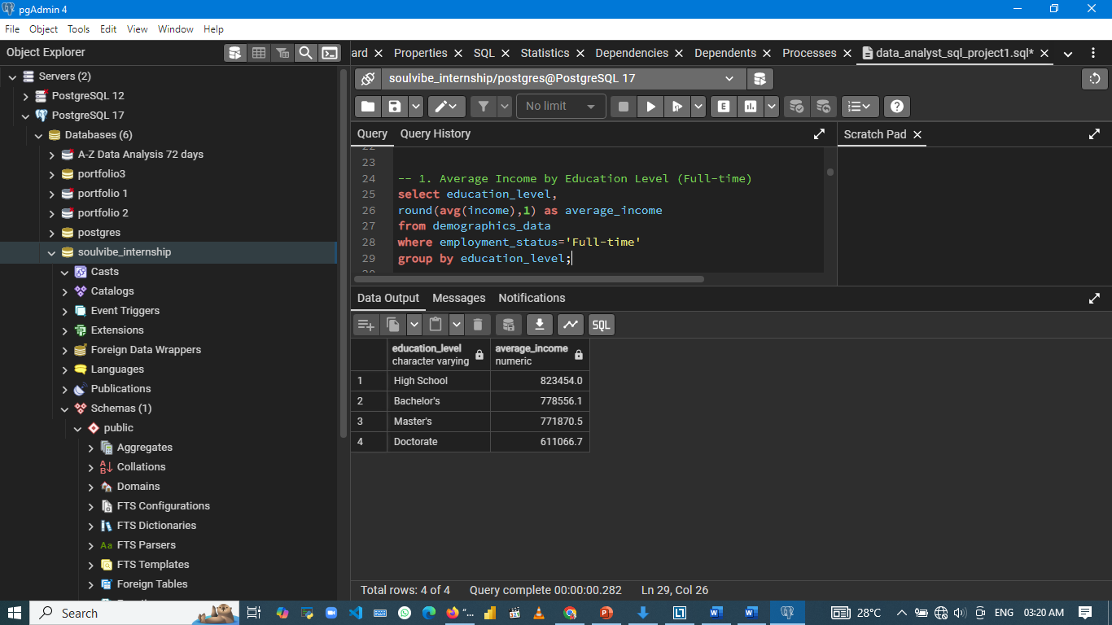
1. Average Income by Education Level (Full-time)

Slide 4
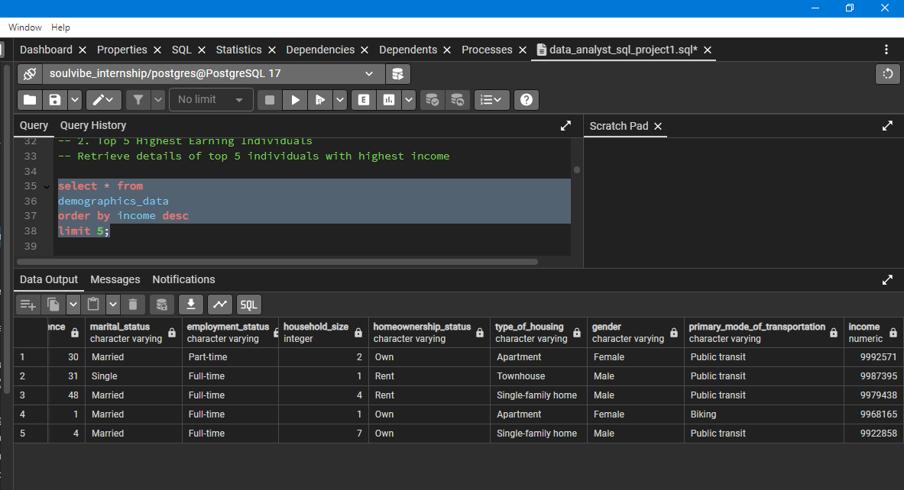
2. Top 5 Highest Earning Individuals

Slide 5
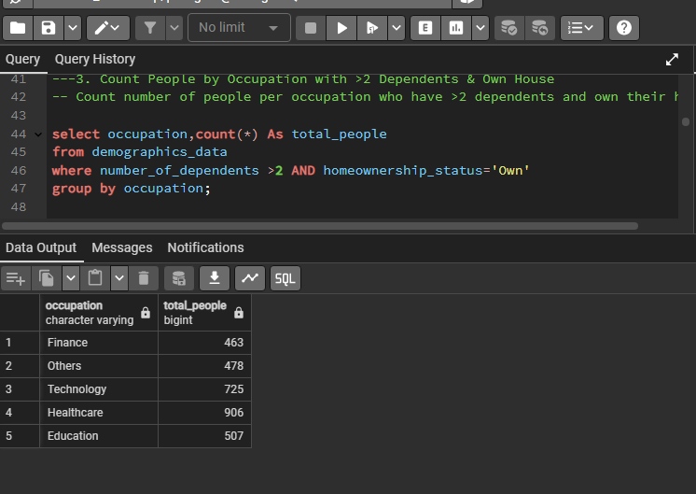
3. Count how many people in each Occupation have more than 2 dependents and own a house

Slide 6
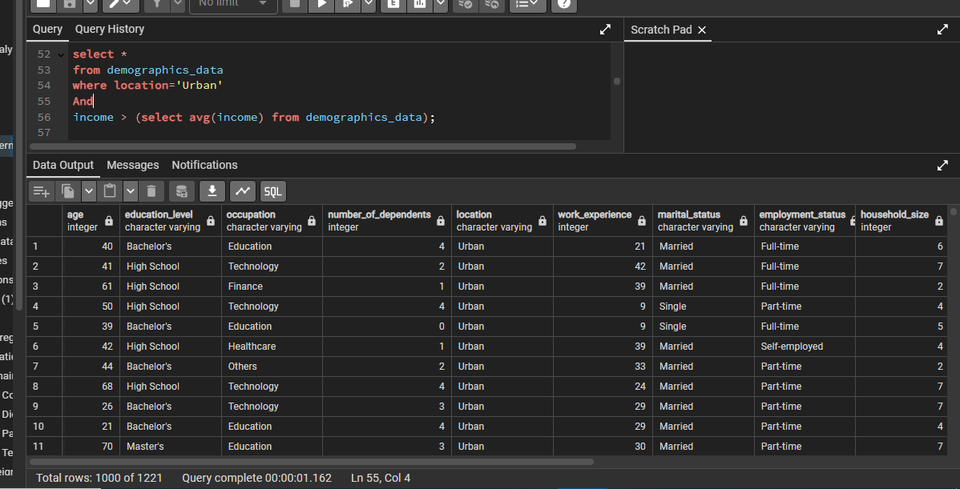
4 all individuals living in Urban locations with an income above the average income.

Slide 7
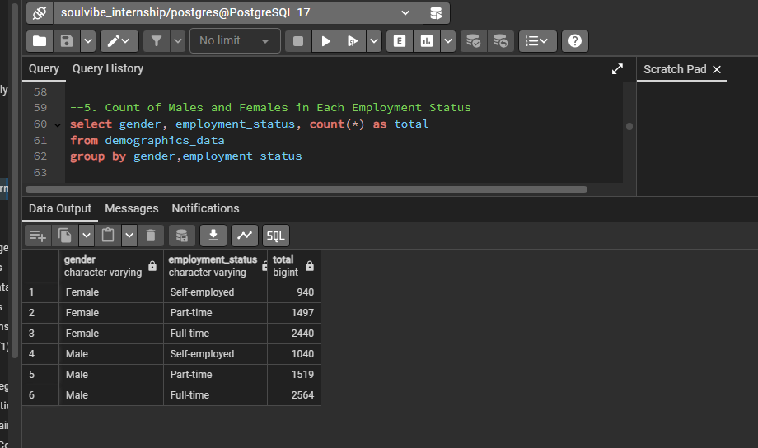
5 Identify how many males and females are in each Employment_Status.

Slide 8
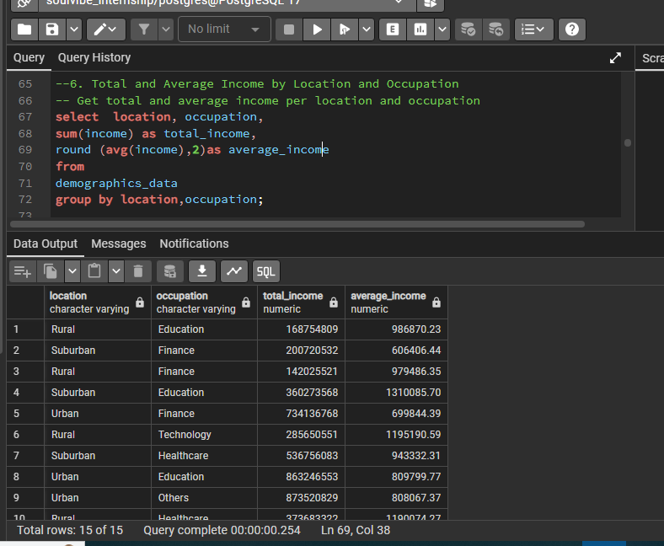
What is the total and average income by Location and Occupation?

Slide 9
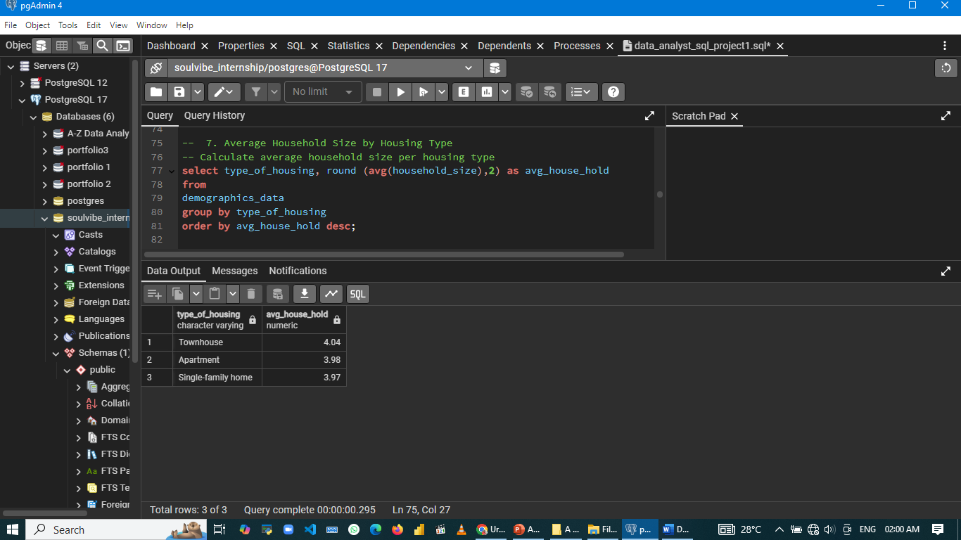
7 Find the average Household_Size grouped by Type_of_Housing.

Slide 10
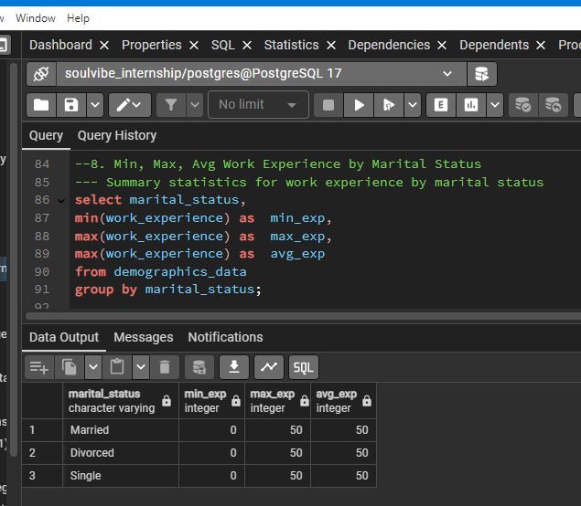
8 the minimum, maximum, and average Work_Experience for each Marital_Status.

Slide 11
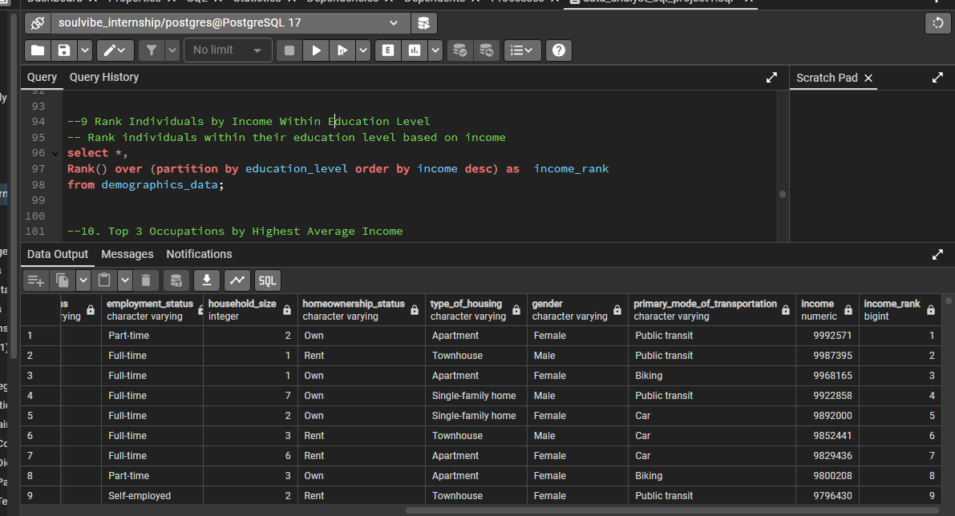
9 Query to rank individuals by Income within each Education_Level.

Slide 12

10 Find the top 3 Occupation types with the highest average income.

Slide 13
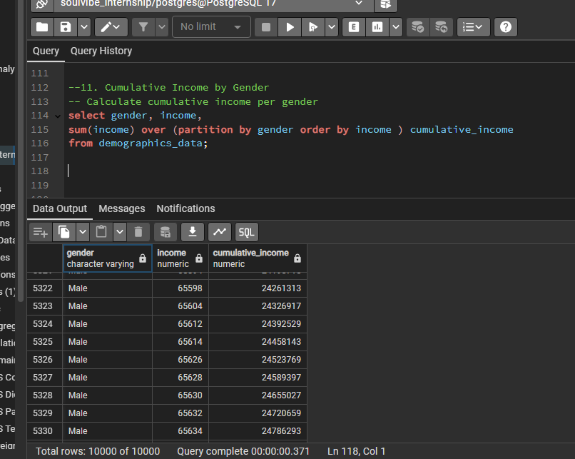
11 Use a window function to calculate the cumulative income for each Gender.

Slide 14
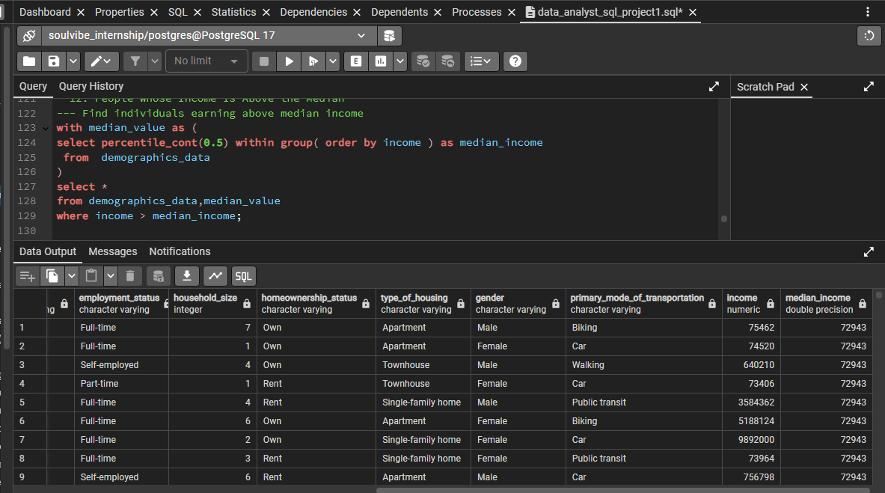
12. List the people whose income is above the median income for the dataset.

Slide 15
conclusion
Through this project, I successfully leveraged SQL to analyse and uncover insights from a demographic and income dataset. By writing and executing 12 structured queries, I was able to:
Identify income disparities across education levels and occupations
Explore household and lifestyle trends based on housing, dependents, and transportation
Rank individuals and track cumulative income patterns using advanced SQL functions
Highlight gender and employment distribution, and surface key outliers like top earners
Apply statistical functions such as median and percentile to derive deeper insights
Key Takeaways
SQL is a powerful tool for extracting, summarizing, and analyzing structured data efficiently
Demographic and income data reveals critical patterns useful for decision-making in areas like financial inclusion
Explored how variables like education, gender, occupation, and marital status impact income and lifestyle trends

Slide 16
Thank you

